Slide 1
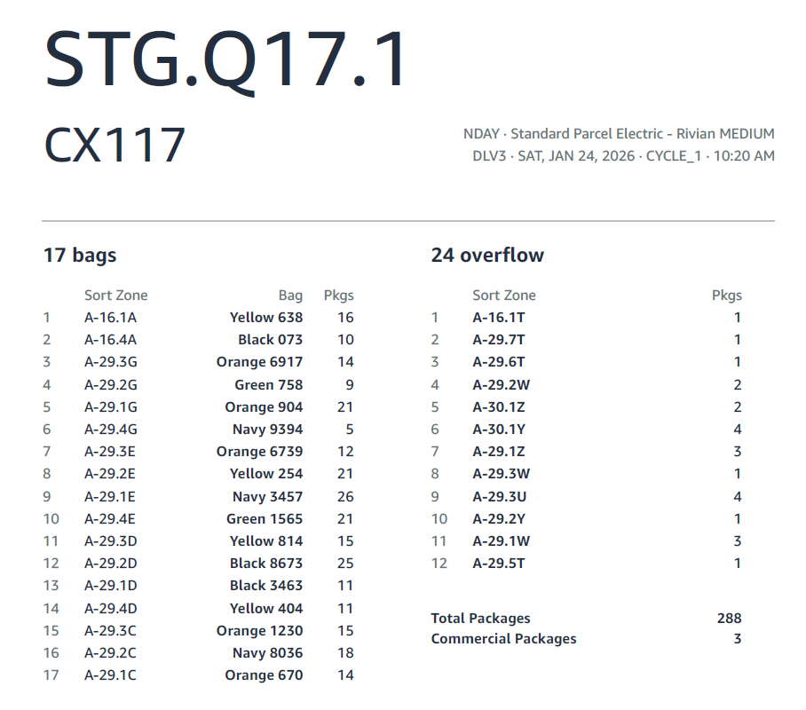
Staging location matches DOP column “L”
Route Code / Route / Route Number. Also column B of DOP
DOP Col “C” aka “Service Type”
DOP Col “A” aka “DSP”
DOP Col “D” aka “Wave Time”
Total Bags and Overflow, we will call overflow “OV” on all reports
Sorting zone for the oversize bags. We do not want the leading alpha character or “-”.
Quantity of packages per sort zone. This will be used on the driver Handouts. Here you can see 16.1T has only one package
Bag ID. Here it shows the full color name but we will use a three letter abbreviation “ORG” for orange.

